Slide 1





LANGUAGE IDENTIFICATION FROM SHORT AUDIO CLIPS USING MFCC AND CLASSICAL ML
Presented By:
GROUP 10
AARON R
SREEKUTTY SANTHOSH
V A SREEHARI

Slide 2

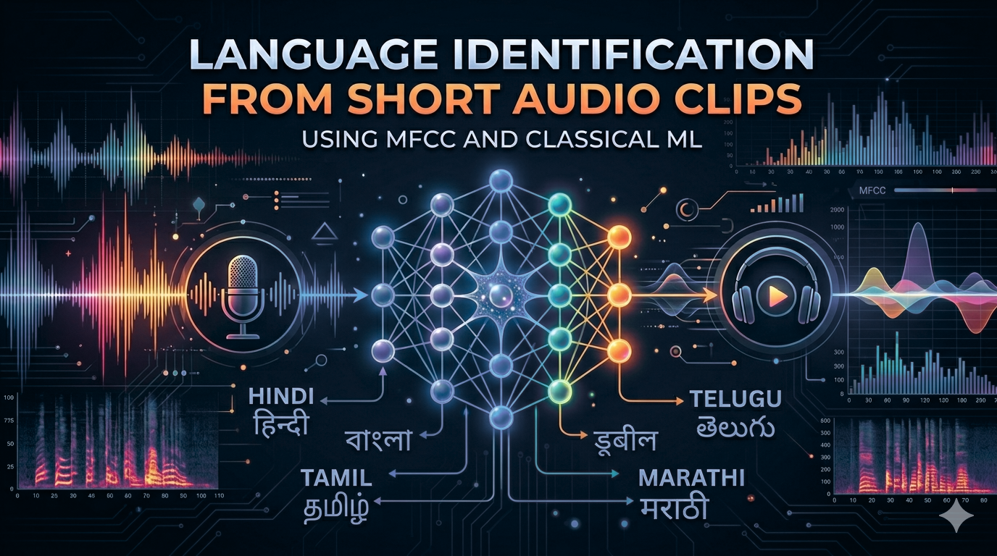

INTRODUCTION
Language Identification (LID) is the task of detecting the spoken language from an audio signal
Focus on short audio clips (3–10 seconds)
Classifies into Malayalam, Tamil, Hindi, English, and Kannada
Uses acoustic features like MFCC, pitch, and spectral features
Applies classical ML models (SVM, Random Forest, Logistic Regression)
Does not use deep learning → lightweight and interpretable approach
Challenging due to similarities between Dravidian languages
Useful in voice assistants, call routing, and speech systems

Slide 3



PROBLEM STATEMENT
Develop a machine learning model to classify spoken language from audio
Input: 3–10 second speech clips
Output: One of five predefined languages
Train the model using:
Extracted acoustic features (MFCC, prosodic, spectral)
Supervised learning algorithms
Evaluate performance using:
Macro F1-score
5-fold cross-validation
Ensure the model can:
Handle similarity between closely related languages
Maintain balanced performance across all classes

Slide 4

DATA SOURCE
Dataset collected from open-source speech corpora
~1000 audio samples per language
~5000 audio clips in total
Balanced across all classes
Suitable for fair evaluation using Macro F1-score
Language
Source
Malayalam
OpenSLR (SLR63)
Tamil
OpenSLR (SLR65)
Hindi
GV_Eval_3h
LibriSpeech (SLR12)
English
Kannada
OpenSLR (SLR79)

Slide 5

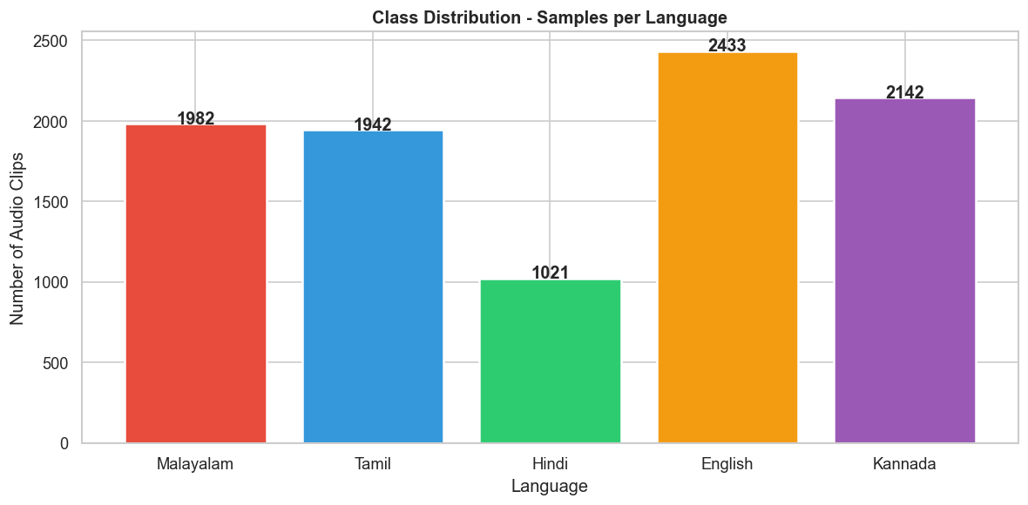

Class Distribution
Dataset is largely balanced across all 5 languages
Balanced data ensures fair evaluation using Macro F1-score
Minor imbalance is handled using class_weight = 'balanced'

Slide 6
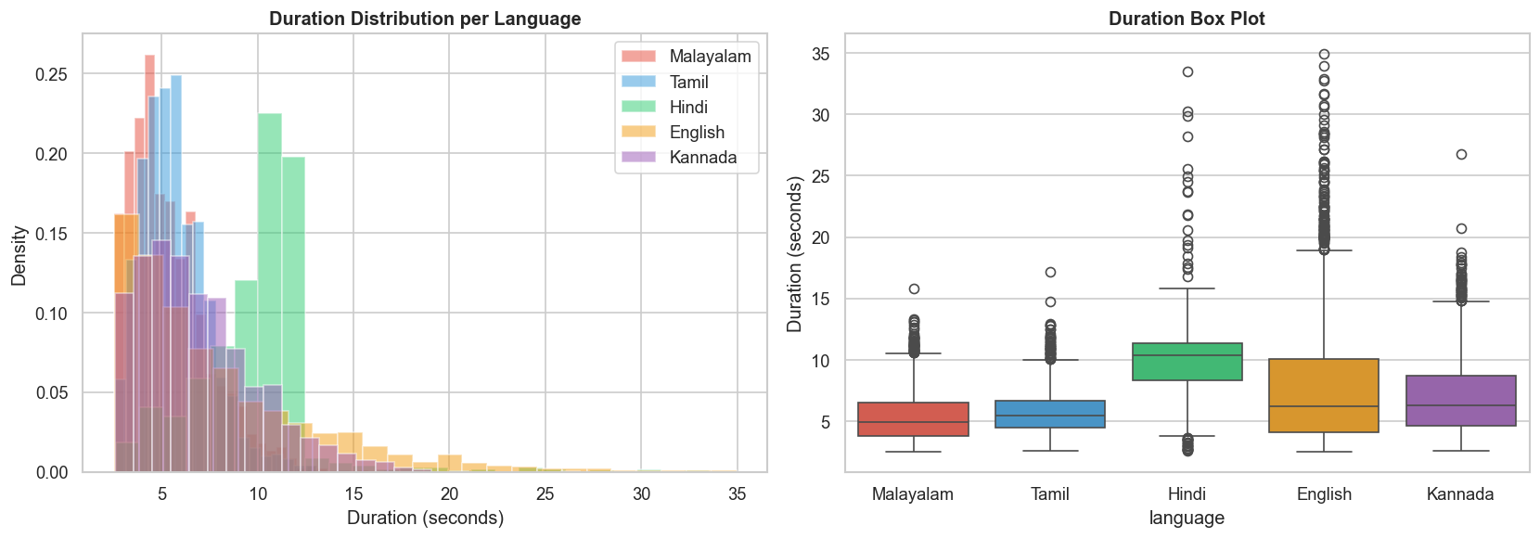
Duration Distribution
Shows variation in audio clip durations across languages
All clips are standardized to 5 seconds during preprocessing
Ensures consistent and fair feature extraction

Slide 7
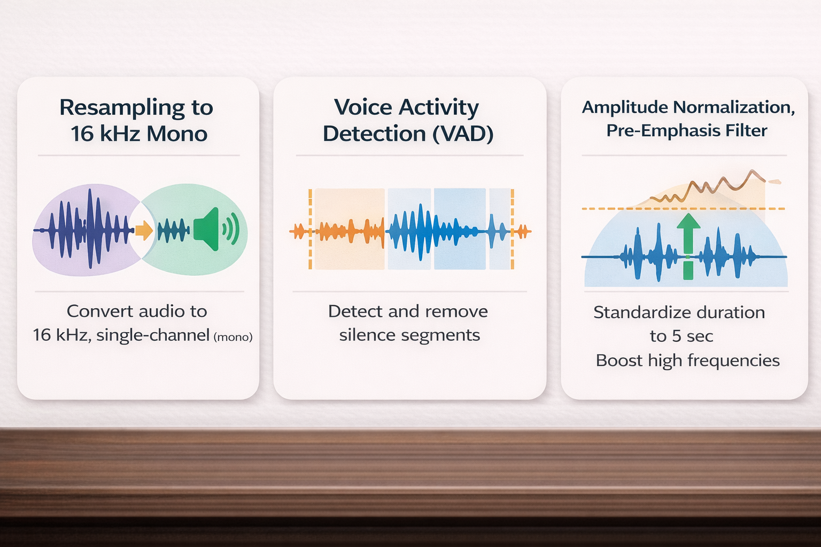

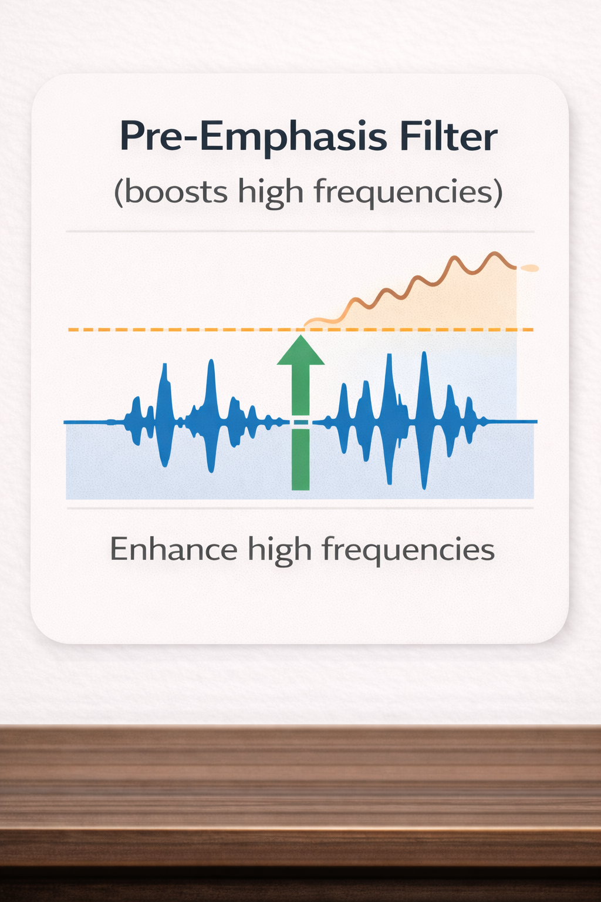
DATA PREPROCESSING
01
Resampling to 16 kHz mono
02
Voice Activity Detection (VAD) → removes silence
Standardizing duration to 5 seconds
03
Amplitude normalization (RMS normalization (RMS = 0.1))
04
Pre-emphasis filter to boosts high frequencies (α = 0.97)
05

Slide 8
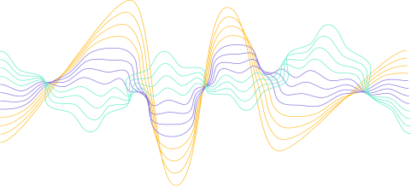
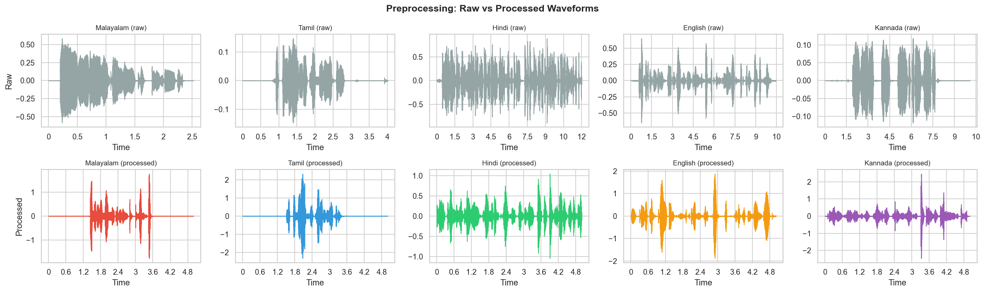
PREPROCESSING: RAW VS PROCESSED AUDIO

Slide 9
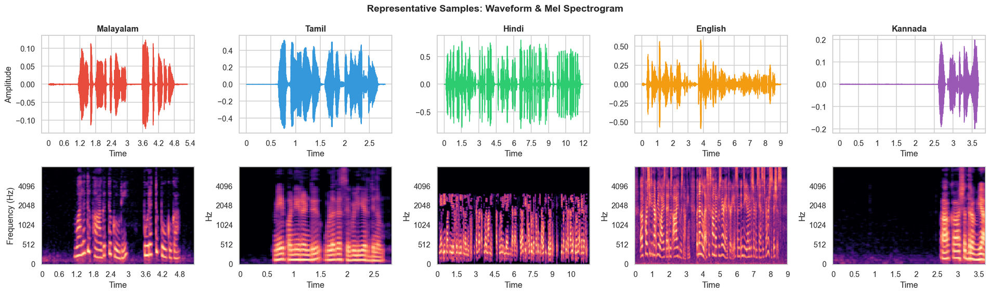

EDA : WAVEFORMS & SPECTROGRAMS
Waveforms and spectrograms show acoustic patterns of each language
Dravidian languages show energy concentrated in 1–3 kHz range
English shows more high-frequency distribution
Each language has distinct spectral signatures

Slide 10
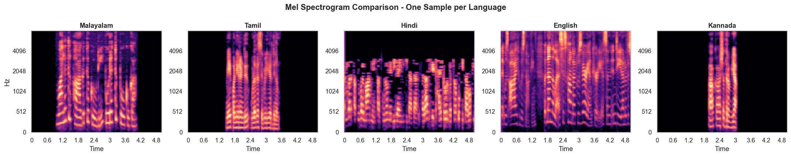
EDA : SPECTROGRAM GRID
Spectrograms show frequency patterns across different languages
Enables direct comparison of spectral energy distribution
Each language exhibits distinct acoustic signatures
These patterns are captured using MFCC features

Slide 11
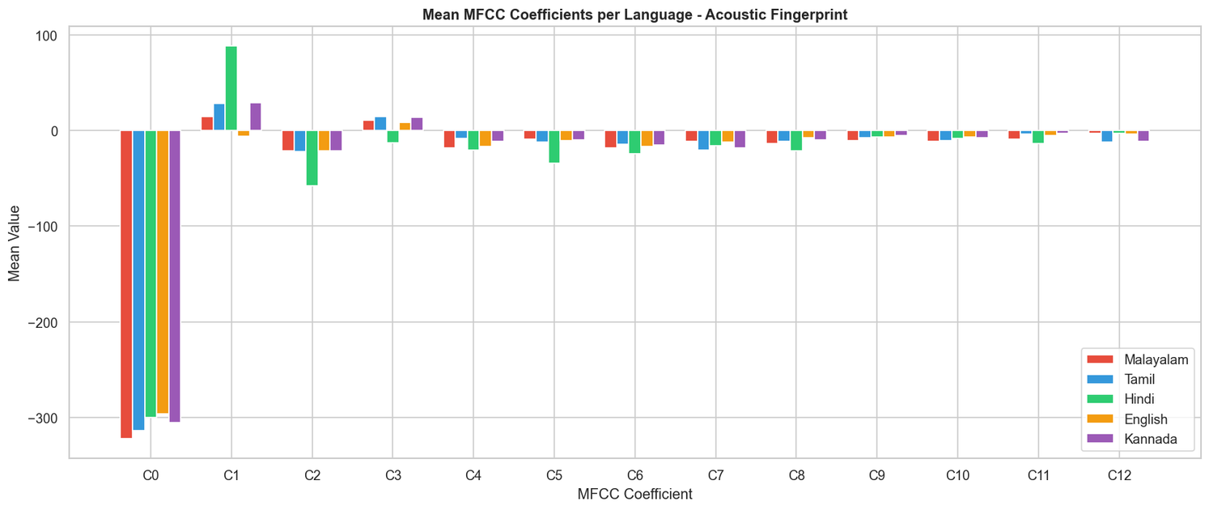
EDA : MFCC PROFILES
MFCC features show clear variation across languages
Lower-order coefficients (C1–C5) capture overall spectral shape
Languages form distinct but slightly overlapping patterns
Dravidian languages cluster together but are still distinguishable

Slide 12
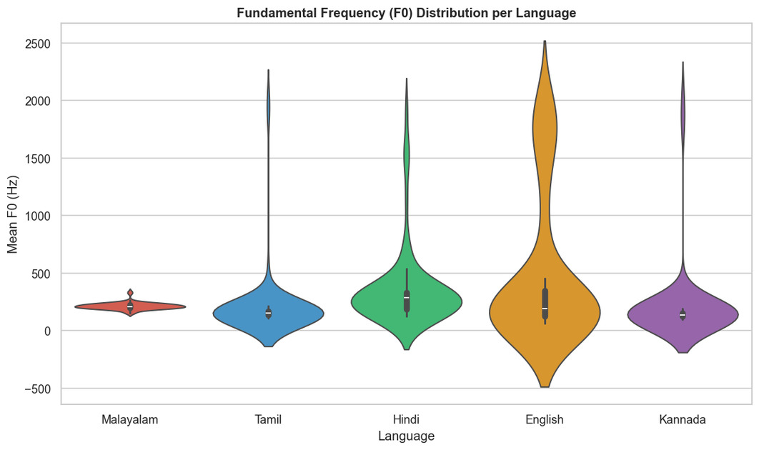
EDA – PITCH (F0) DISTRIBUTION
Waveforms and spectrograms show acoustic patterns of each language
Dravidian languages show energy concentrated in 1–3 kHz range
English shows more high-frequency distribution
Each language has distinct spectral signatures

Slide 13
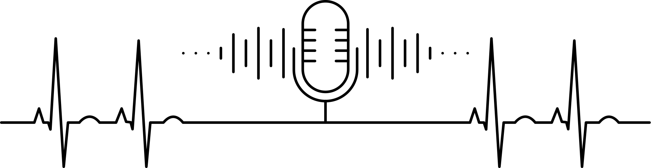
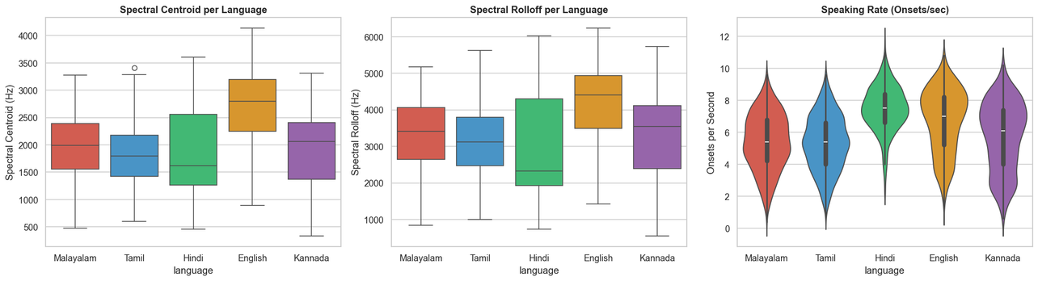
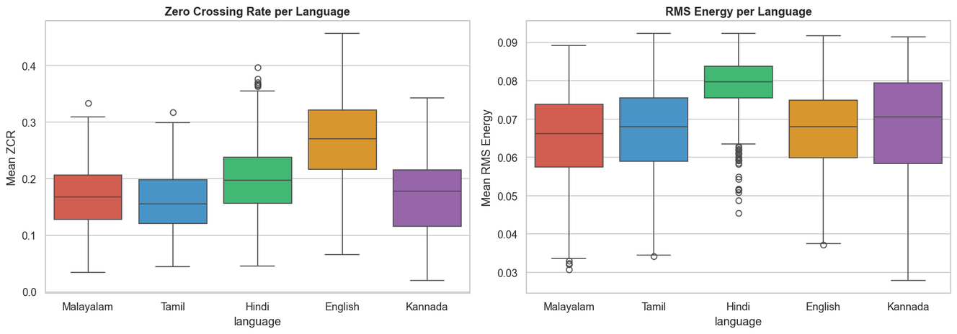
EDA
ZCR & RMS ENERGY
ZCR(Zero Crossing Rate): Rate of zero crossings (indicates voiced/unvoiced patterns)
RMS Energy: Represents signal loudness
Both features show measurable differnces between languages
Useful for capturing speech and phonetic differences
SPECTRAL CENTROID & SPEAKING RATE
Spectral centroid reflects frequency characteristics (consonant vs vowel energy)
Speaking rate reflects speech speed and timing
Both vary across languages
Reflect differences in consonant–vowel patterns and syllable timing

Slide 14

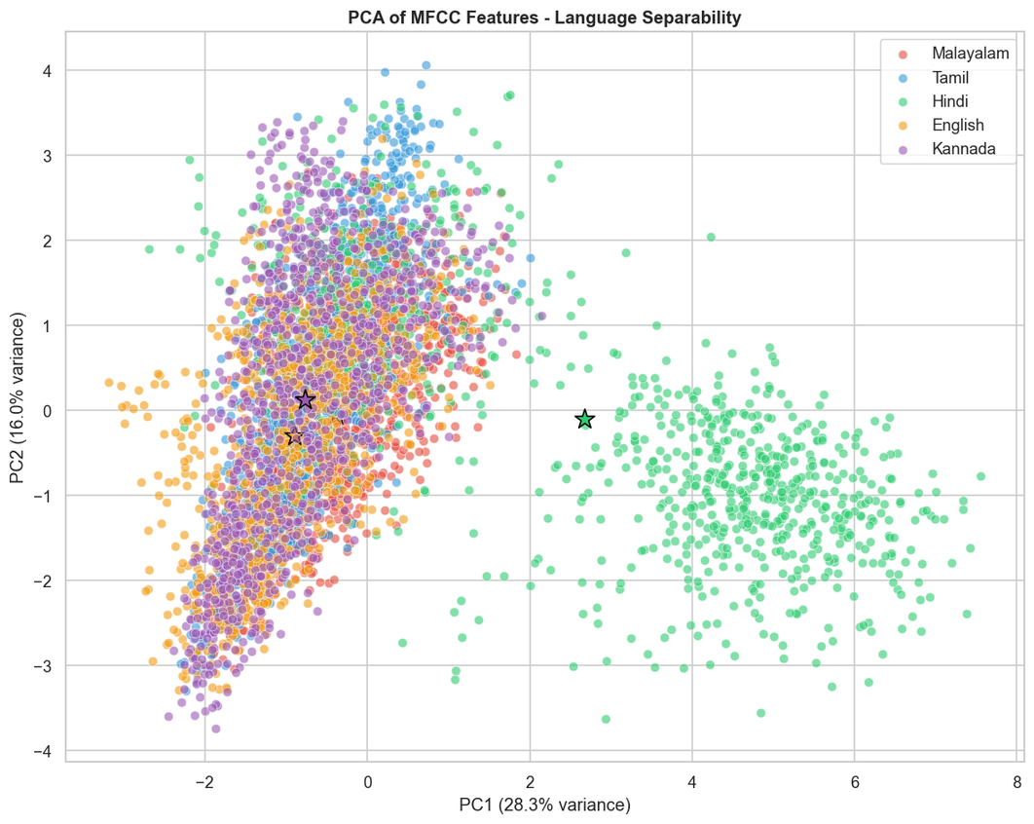
EDA : PCA
PCA reduces high-dimensional features into 2D for visualization
Feature space shows reasonable separability between languages
Dravidian languages show overlapping but distinguishable clusters
Indicates extracted features are effective for classification

Slide 15


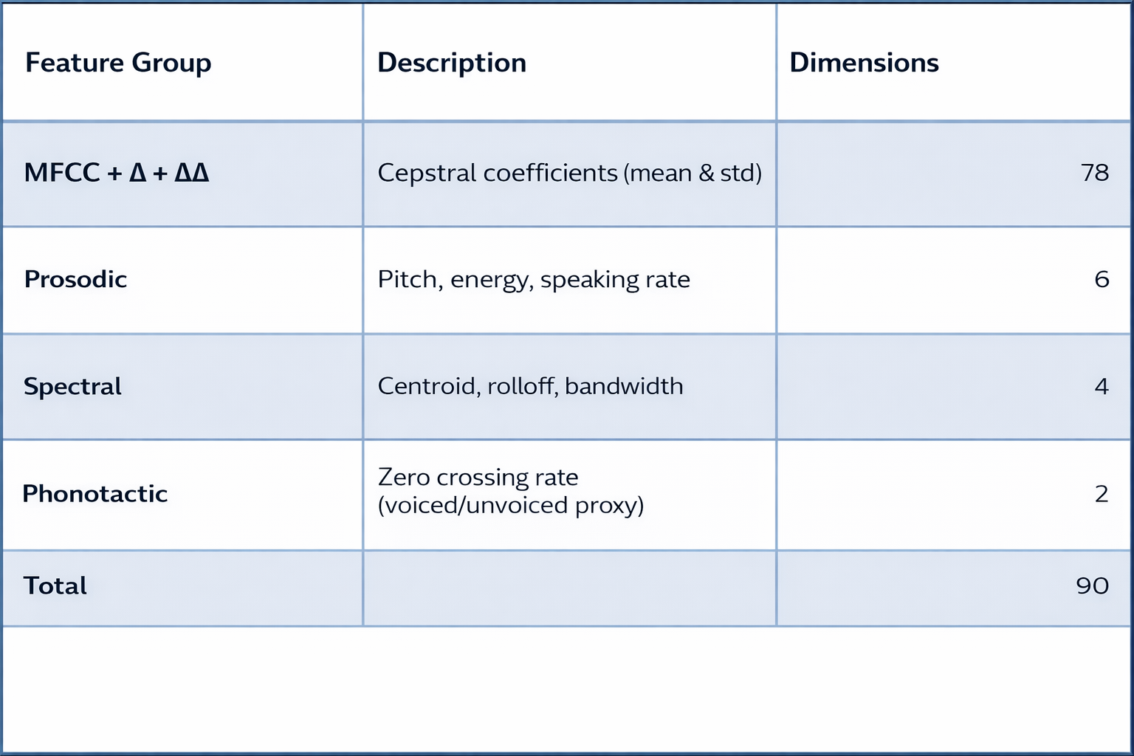
Feature Engineering & Selection
Extracted MFCC, prosodic, spectral, and ZCR features
Total 90 features
Features standardized using StandardScaler (zero mean, unit variance)
Selected top 70 features using SelectKBest for model training

Slide 16
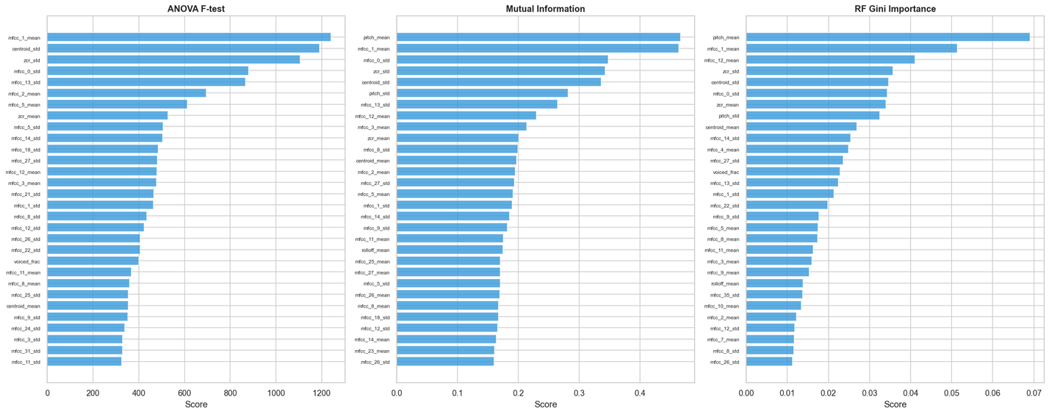
Feature Engineering & Selection
FEATURE SELECTION RESULTS
Feature importance identifies the most discriminative power
MFCC features (especially Δ and ΔΔ) are most informative
Prosodic and spectral features also contribute
Top 70 features selected from 90 using mutual information

Slide 17
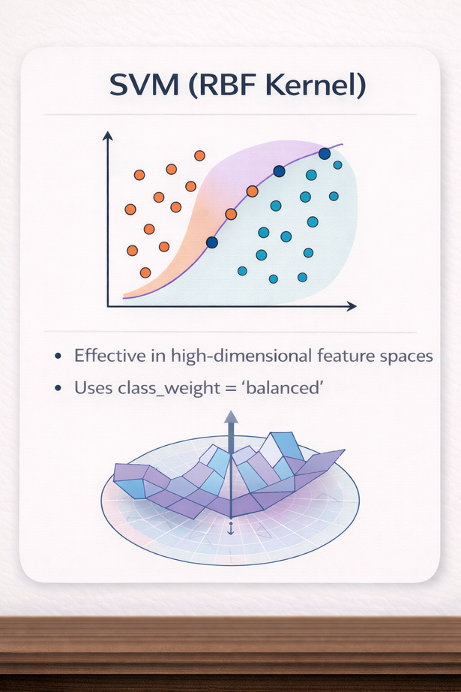
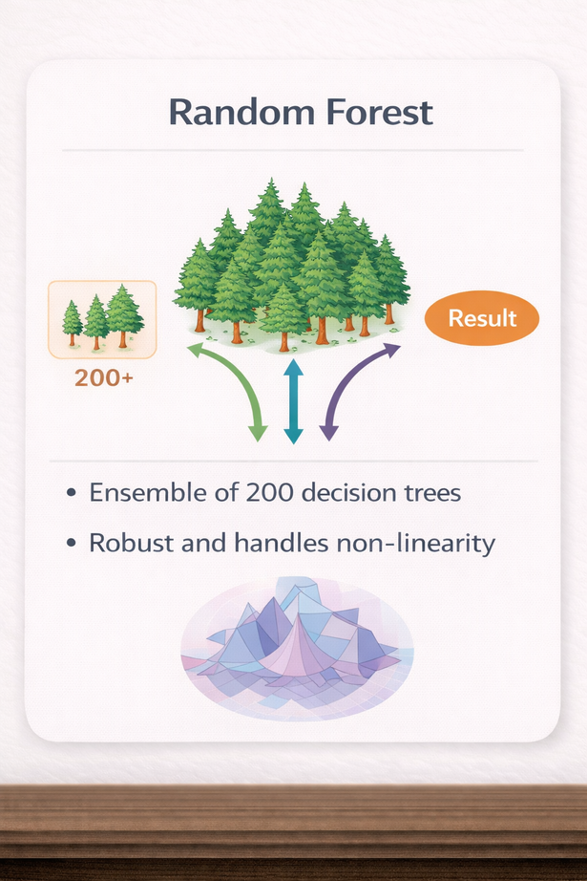
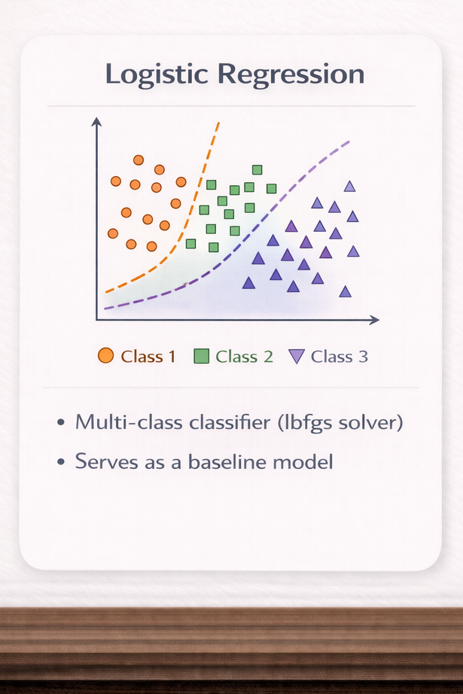

Model Building & Training
Training setup:
Stratified 5-fold cross-validation
Trained on 70 selected features
Features are standardized before training
SVM (RBF Kernel)
Random Forest
Logistic Regression
Effective in high-dimensional feature spaces
Uses class_weight = 'balanced'
Ensemble of 200 decision trees
Robust and handles non-linearity
Multi-class classifier (lbfgs solver)
Serves as a baseline model

Slide 18
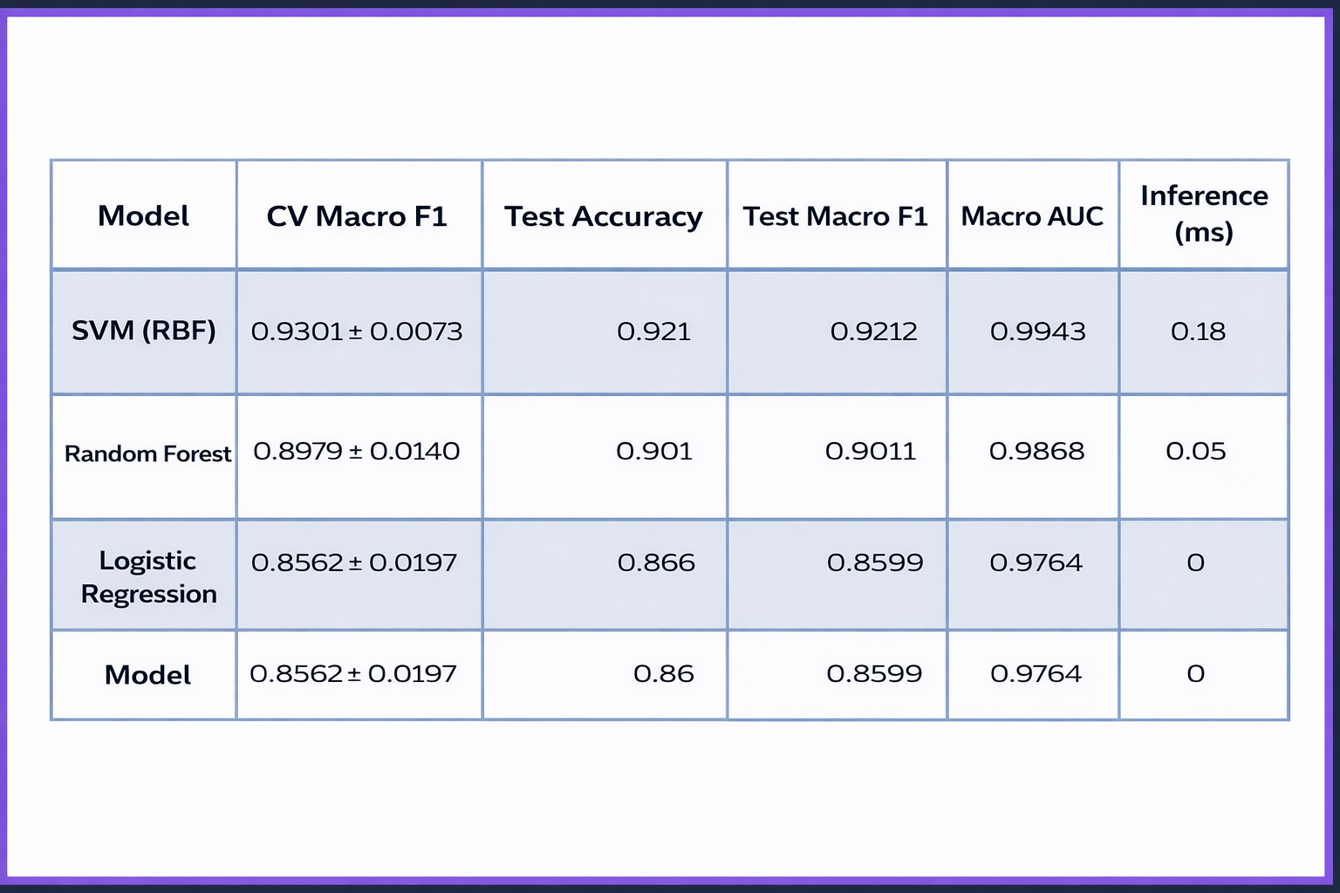
MODEL EVALUATION & COMPARISON
SVM (RBF) achieves the best performance
Macro F1 of 0.93
Accuracy of 92.1%
Random Forest performs slightly lower but remains strong
Logistic Regression provides a baseline performance (~86%)
Overall, non-linear models outperform linear models

Slide 19
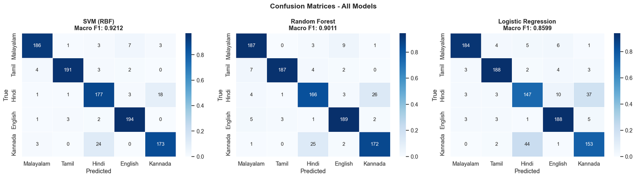
CONFUSION MATRICES
Confusion matrix shows correct vs misclassified predictions
Most predictions lie on the diagonal → high accuracy
Errors mainly occur between closely related Dravidian languages
(Malayalam, Tamil, Kannada)
Confusion pattern aligns with linguistic similarity

Slide 20
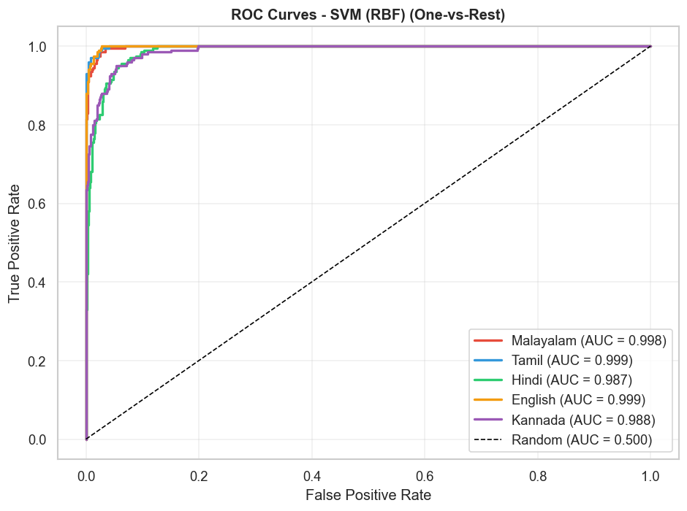
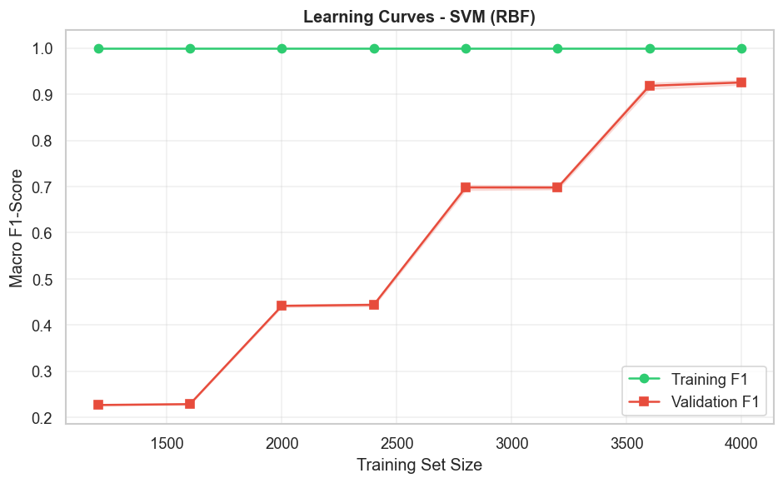
ROC CURVES
LEARNING CURVE
ROC curve shows True Positive Rate vs False Positive Rate
All classes achieve high AUC (> 0.97)
SVM achieves highest Macro AUC (~0.994)
Shows performance vs training data size
Validation score improves as data increases
Training and validation curves are close
Indicates good generalization
No evidence of severe overfitting

Slide 21
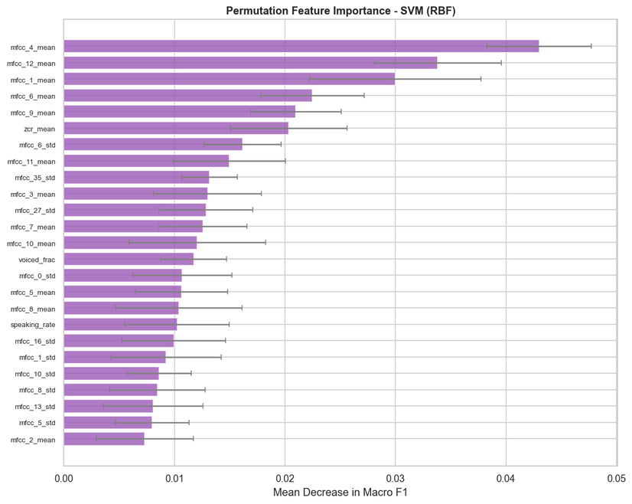
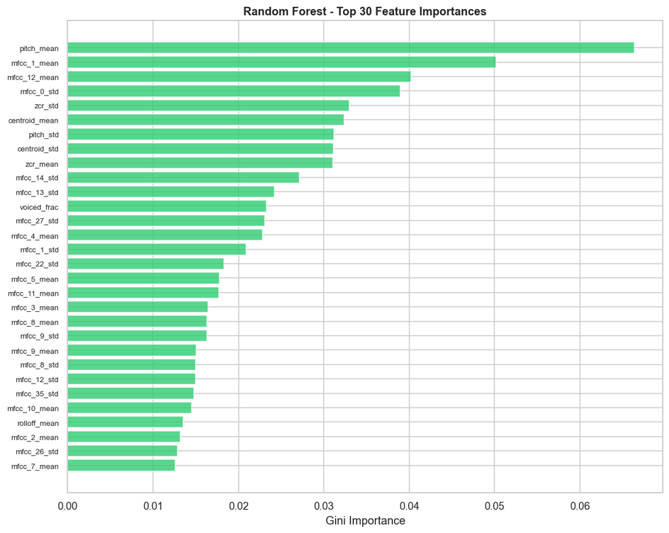
MODEL INTERPRETATION & EXPLAINABILITY
Permutation Importance
Random Forest Feature Importance
Shows importance of features based on model impact
MFCC features are the most influential
Delta (Δ) and Delta-Delta (ΔΔ) coefficients are highly important
Indicates the importance of temporal dynamics in langugage identification
Shows feature importance based on Random Forest (Gini importance)
Confirms MFCC features are most important
MFCC standard deviations (Δ, ΔΔ) rank highly
Prosodic features (pitch, energy) also contribute

Slide 22

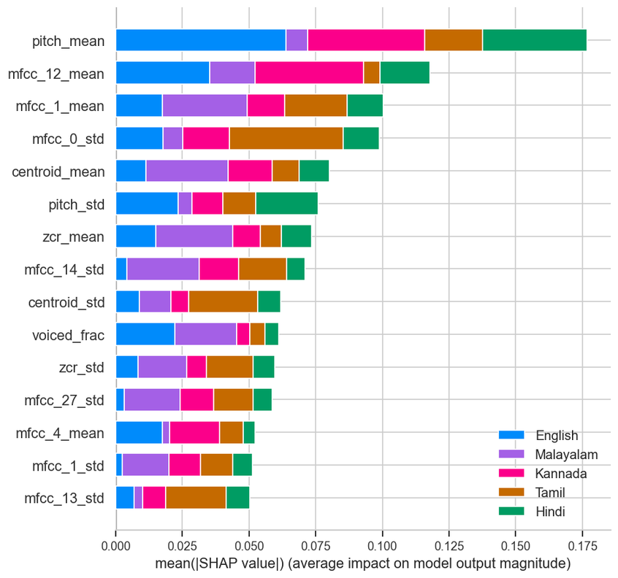
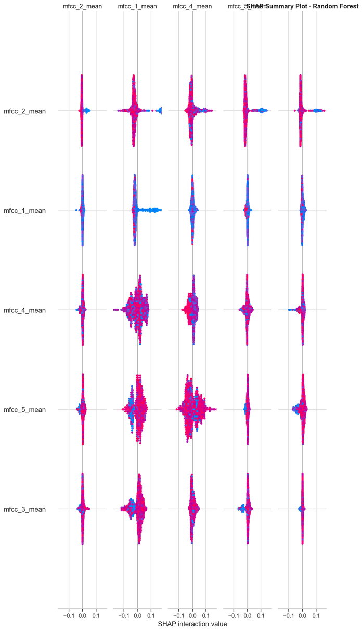
SHAP ANALYSIS
MFCC dynamics dominate language discrimination
how each feature contributes to pushing the prediction toward or away from each language class.
provide a global view of feature importance
Ranks features based on mean absolute SHAP values
Shows overall importance across all predictions
MFCC features and pitch are most influential

Slide 23



DEPLOYMENT – STREAMLIT WEB APP
Overview
Best-performing model (SVM with RBF kernel) deployed using Streamlit
Enables real-time language identification
Key Features
Upload audio files (WAV / MP3 / FLAC)
Visualize waveform & Mel spectrogram
Display class probability predictions
Acoustic feature analysis (radar chart)
Multi-model comparison view
Run Locally
Install dependencies: pip install -r requirements.txt
Run application: streamlit run app.py

Slide 24


KEY FINDINGS & CONCLUSION
SVM (RBF) achieves best performance
→ Accuracy: 92.1%, F1-score: 0.92
MFCC dynamics (Δ, ΔΔ) are the most discriminative features
Dravidian languages show higher confusion rates
→ due to linguistic similarity
Multi-feature approach outperforms single-feature methods
All models exceed baseline (20%) and target (78% F1)

Slide 25
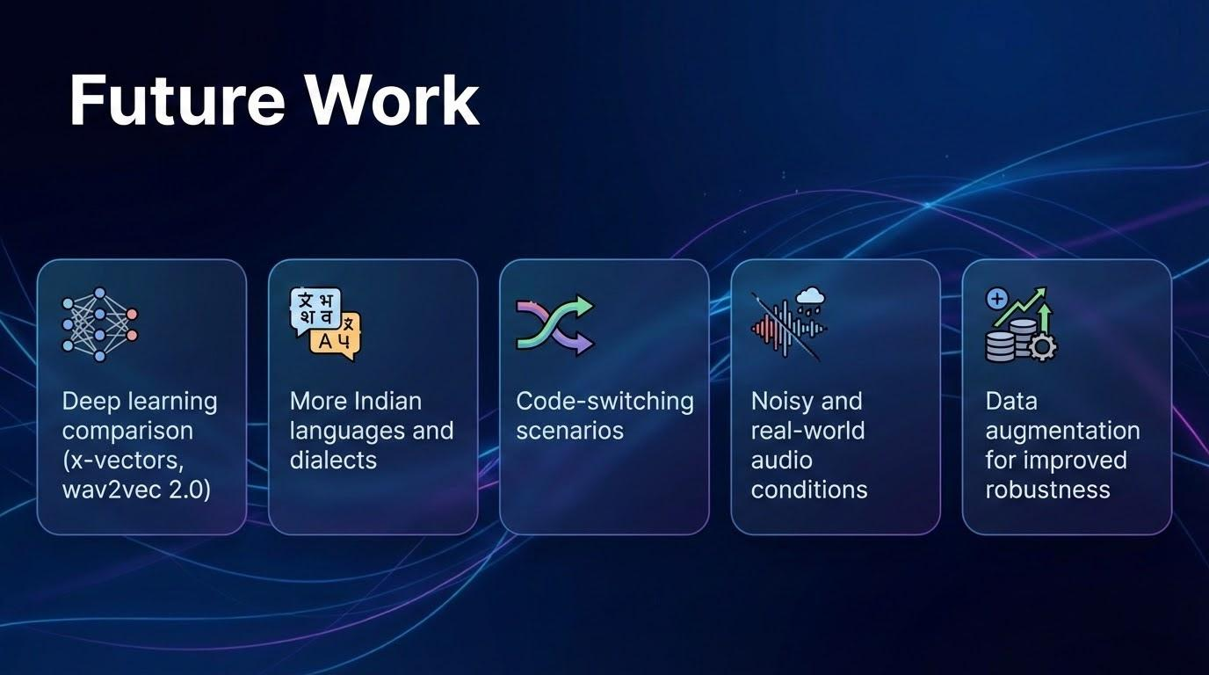

Slide 26

THANK YOU
0:53
3:15

